Slide 1
PC613: Communication Skills
Sem I, MSc IT
Instructor: Dr. Jenson Joseph

Slide 2
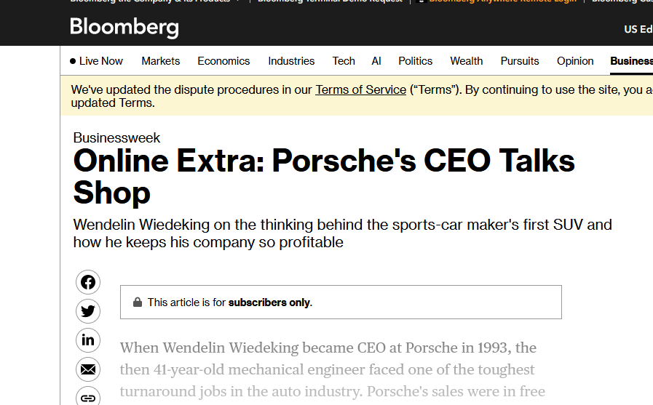
Learn an idiom
“to talk shop”

Slide 3

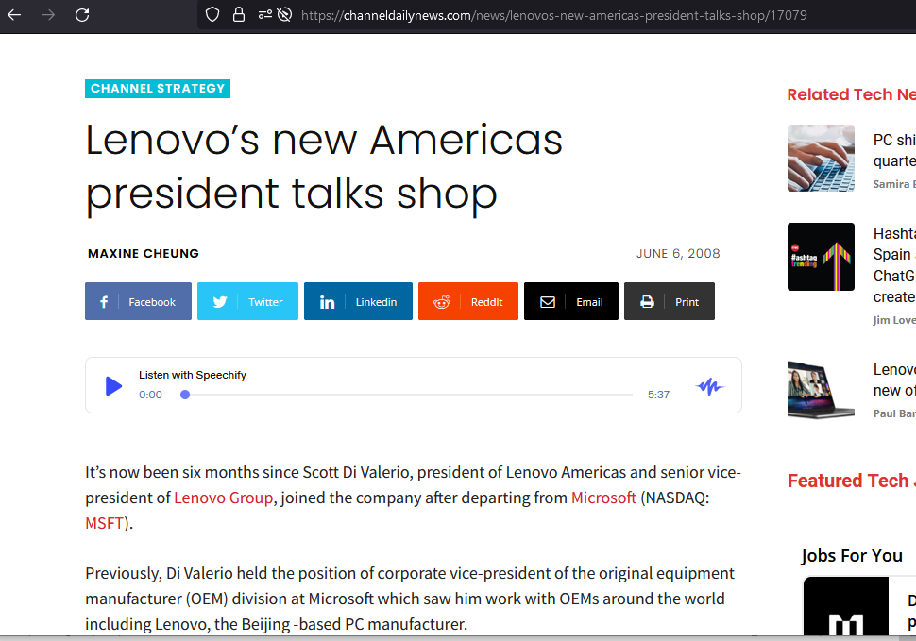
Learn an idiom
“to talk shop”

Slide 4
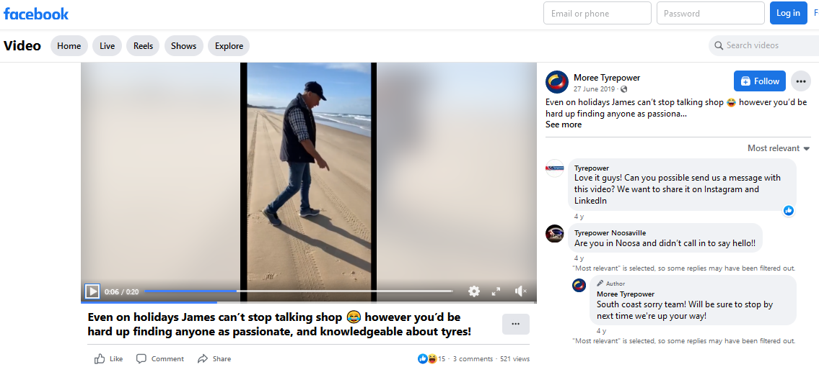
Learn an idiom
“to talk shop”

Slide 5
Learn an idiom
“to talk shop”
To talk about work, even when you are not at work, or with who you work
Examples:
We need to talk shop for a minute.
We went to the pub to celebrate Rob’s birthday but inevitably we started talking shop!
I bumped into my boss on the train home tonight and he talked shop all the way to my stop.
We’ve been at work all day, let’s all have some fun and not talk shop… please!

Slide 6
Quick revisions
Lose vs loose
Lose (functions only as a verb): to fail to win or, to fail to hold onto something.
One might “lose a game”, “lose a wallet” or “lose one’s temper.”
Lose has such meanings as “to bring to destruction,” “to miss from one's possession or from a customary or supposed place,” or “to undergo defeat in.”

Slide 7
Quick revisions
Ways to use ‘Lose’
Lose one’s temper -- to get angry: “Losing his temper, the lion seized the mouse with his paw and was about to kill it”.
Lose one’s mind -- to go insane: “He was having suicidal thoughts. He was losing his mind.”
Lose one’s way -- to become lost (often used figuratively); to lose perspective:
-- “Is there a method to Musk’s madness on Twitter, or has he simply lost his way”?
-- “How did America lose its way in Afghanistan?”
Lose one’s head -- to become very upset or angry: “Roy Keane claims Manchester United star Christiano Ronaldo ‘has had enough’ and lost his head”.
Lose one’s nerve -- to become too anxious: “If you lose your nerve, you suddenly panic and become too afraid to do what you were about to do.”
Lose count -- to forget a number or total: “I have lost count of the number of times I have seen Dil Chahta Hai”.

Slide 8
Quick revisions
Ways to use ‘Lose’
Lose face -- to lose other people's respect: “He was afraid that he would lose face if he admitted his mistake.”
Lose it -- lose one's composure/to fail to maintain a hold on reality: “I was so angry that I almost lost it.”
Lose out -- fail to receive an expected reward or gain:
The new tax means that the vast majority of working people will lose out.
Even software engineers in Silicon Valley, who were once uniquely in demand, now appear to be at the risk of losing out on salary gains to those with more AI expertise.
Lose sleep over -- to worry about (something) so much that one cannot sleep (usually used in negative statements): “I’m not losing any sleep over it”.
Lose one’s grip -- to lose control of one's thoughts and emotions.

Slide 9
Quick revisions
Loose vs lose
Loose can be used as an adjective (meaning, "not securely attached"), and as a verb ("to free something or someone").
Loose cannon - a dangerously uncontrollable person or thing:
if someone is a loose cannon, they do whatever they want and nobody can predict what they are going to do.
Donald Trump is a loose cannon politically.
Loose-lipped - given to unrestrained talk
Siddhu has the image of being loose-lipped.
Have a screw loose -- to be mentally unbalanced (informal)
All hell breaks loose -- used to describe what happens when violent, destructive, and confused activity suddenly begins.

Slide 10
Quick revisions
Little vs less
Little and few have negative meanings: they mean ‘not as much as expected or wished for’ or ‘none’/’almost none’.
A little and a few are quantifiers meaning ‘some’.
Examples:
All she wanted was a few moments on her own. (some moments, a small number)
She had few moments on her own. (not many/almost none)
She saves a little money every month.
They had little money to spend.
She has little time to spare.
I’m not very happy about it but I suppose I have little choice.
Few cities anywhere in Europe can match the cultural richness of Berlin.

Slide 11
Quick revisions
Less, fewer
We use the quantifiers less and fewer to talk about quantities, amounts and degree.
Examples
I do less work at weekends than I used to. (less because work is not countable).
Better roads mean fewer accidents. (fewer, because accidents can be counted)
I have less homework to do today than I had yesterday.
When a particular area gets less rain than usual, the soil gets much less moisture, too.
It rained less last month than it has so far this month.
I need to eat less butter.
Maya sings less than she did in college.
Why are there fewer and fewer honest people in the world?

Slide 12
Lose vs loose; less/few vs little
Revision summary
Lose functions only as verb; means ‘to undergo defeat in’, ‘to fail to keep possession of something’, or ‘to bring to destruction’ (when talking about one’s temper, mind, and so on…)
Loose is used as an adjective, meaning, ‘not securely attached’, or as a verb to mean ‘to free someone or something’
A little and a few are quantifiers meaning ‘some. Little and few usually mean ‘almost none’ or ‘none’.
We use the quantifiers less and fewer to talk about quantities, amounts and degree.
Less and fewer are to be used in comparative scenarios.
Few and fewer when the we are referring to countable nouns. (Less work, but few/fewer people)

Slide 13
Little / less exercises
Decide whether you have to use little or less:
I have _______ interest in classical music.
I have _______ faith in him.
We need _______ furniture in this room than in the big hall.
You have to drink _______ coffee.
He has _______ money than I thought.
Tonight I drank _______ wine than last night.
She dedicates _______ time to her homework than to her hobbies.
This will take _______ time to finish than the last time we tried.
He has _______ interest in what others have to say.
I have _______ information to share on the matter.

Slide 14
Little / less exercises
Decide whether you have to use little or less:
I have _______ interest in classical music. (little)
I have _______ faith in him. (little)
We need _______ furniture in this room than in the big hall. (less)
You have to drink _______ coffee. (less)
He has _______ money than I thought. (less)
Tonight I drank _______ wine than last night. (less)
She dedicates _______ time to her homework than to her hobbies. (less)
This will take _______ time to finish than the last time we tried. (less)
He has _______ interest in what others have to say. (little)
I have _______ information to share on the matter. (little)

Slide 15
Little, less, few or fewer: exercises
Right or wrong?
I find it very difficult to manage my monthly expenses because I get less salary.
He makes less money than her wife does.
There are less eggs in the fridge than you think.
There were fewer students in school due to the weather.
I’d like to put less salt in my soup.
I used to make much fewer money two years ago.
I have fewer pairs of shoes than I used to have.
She left less than five minutes ago.
There is less biscuits in the box than I had expected.
He has less friends in this town than his father.

Slide 16
Little, less, few or fewer: exercises
Right or wrong?
I find it very difficult to manage my monthly expenses because I get less salary. (…I get little/very little salary).
He makes less money than her wife does.
There are less eggs in the fridge than you think. (fewer eggs)
There were fewer students in school due to the weather.
I’d like to put less salt in my soup.
I used to make much fewer money two years ago. (less money)
I have fewer pairs of shoes than I used to have.
She left less than five minutes ago.
There is less biscuits in the box than I had expected. (fewer biscuits)
He has less friends in this town than his father. (fewer friends)

Slide 17
Common mistakes among Indian English speakers
Identify the language mistake and rectify
I am having four brothers and three sisters.
He do not have a laptop. / Does she has a car?
"Today office is there?" (Answer): "No office is not there. Today is Bharat bandh."
Last before year she got very good marks.
He did not wrote the test last week.
I cannot cope up with this pressure.
I came to office by walk.
What is the time in your watch?
Our classroom is in the 2nd floor.
He has white hairs.
I prefer coffee than tea.

Slide 18
Common mistakes among Indian English speakers
Identify the language mistake and rectify
I am have four brothers and three sisters.
He does not have a laptop. / Does she have a car?
"Is today a working day?" / “Are we working today?” (Answer): “No, we are not working today.”
Year before last she got good marks. (Correct phrases: Month before last, Day before last, Week before last.)
He did not write the test last week.
I cannot cope up with this pressure.
I came to office on foot.
What is the time by your watch?
Our classroom is on the 2nd floor. I am on campus. There is a chair lying around on the corridor.
He has grey hairs.
I prefer coffee to tea.

Slide 19
Lesson 1: Introducing Oneself
Follow the format given below, but feel free to improvise
Begin with:
Hi everyone
Hello friends
Good morning, everyone/Good morning, all/Good morning, guys
Proceed to: “I am ….; I come from…; my hobbies are…/ I like..; This is the first time I…”
End with pleasantries, like:
I look forward to knowing you all better
Wish you all a great time on campus
Hope you all enjoy your time in DA-IICT

Slide 20
https://www.youtube.com/watch?v=4G-YQA_bsOU
https://genius.com/Simon-and-garfunkel-bridge-over-troubled-water-lyrics

